Slide 1
Comparing Exponential and Linear functions

Slide 2
Let’s analyze how y changes when x increases by 1, for linear functions
For linear function y = 2 + 3x:
If x = 0 → y = 2
If x = 1 → y = 2 + 3
If x = 2 → y = 2 + 3 + 3
If x = 3 → y = 2 + 3 + 3 + 3
For linear function y = 5 – 4x
If x = 0 → y = 5
If x = 1 → y = 5 – 4
If x = 2 → y = 5 – 4 – 4
If x = 3 → y = 5 – 4 – 4 – 4
For linear functions, y is added its slope every time x increases by 1.

Slide 3
Now, let’s analyze how y changes when x increases by, for exponential functions.
For exponential function y = 2(3)^{x}
If x = 0 → y = 2
If x = 1 → y = 2 * 3
If x = 2 → y = 2 * 3 * 3
If x = 3 → y = 2 * 3 * 3 * 3
For exponential function y = 4 (0.5)^{x}
If x = 0 → y = 4
If x = 1 → y = 4 * 0.5
If x = 2 → y = 4 * 0.5 * 0.5
If x = 3 → y = 4 * 0.5 * 0.5 * 0.5
For exponential functions, y is multiplied by the growth factor every time x increases
by 1.

Slide 4
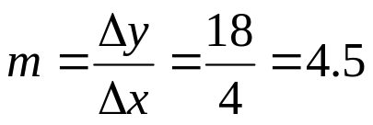
Example 1
Find a linear or exponential function to fit the following data?
x | 6 | 10 | 14 | 18 | 22
y | – 14 | 4 | 22 | 40 | 58
Solution
The values of x in the table change by steps of Δx = 4.
(Lets’ check: 10 – 6 = 4; 14 – 10 = 4; 18 – 14 = 4; and 22 – 18 = 4)
Similarly, the values of y in the table change by steps of Δy = 18.
(Let’s check: 4 – (– 14) = 18; 22 – 4 = 18; 40 – 22 = 18; and 58 – 40 = 18.
Because y increases Δy = 18 each time x increases Δx = 4, the table
represents a linear function (instead of an exponential one.)
Its slope is:
Now, by using (10, 4) and m = 4.5 → y – y_{o} = m(x – x_{o})
Then, y – 4 = 4.5 (x – 10) → y – 4 = 4.5x – 45 →
y = 4.5x – 41
Answer

Slide 5
Example 2
Find a linear or exponential function to fit the following data?
x | 0 | 2 | 4 | 6
y | 10 | 40 | 160 | 640
Solution
The values of x in the table change by steps of Δx = 2.
(Lets’ check: 2 – 0 = 2; 4 – 2 = 2; and 6 – 4 = 2. )
On the other hand, the values of y in the table do not change by a constant step Δy.
(Let’s check: 40 – 10 = 30; 160 – 40 = 120; and 640 – 160 = 480.)
Then, the table does not represent a linear function.
For the table to represent an exponential function, ratios of consecutive y-values
(evenly spaced on the x-axis) must be equal.
Let’s check: 40 / 10 = 4; 160 / 40 = 4; 640 / 160 = 4 Yes!!
Then, the table represents an exponential function.

Slide 6
Notice that the constant ratio 4 that we found is not the growth factor because x was
not increasing by 1 but by 2.
Then, let’s find the exponential function y = ab^{x}. ----- (1)
From table, y = 10 when x = 0.
Then, parameter a in the equation is a = 10. ----- (2)
After replacing (2) in (1): y = 10b^{x} ----- (3)
We just need to find b to know the exponential function completely.
Then, let’s use point (2, 40) from the table an plug it in equation (3)
Then, 40 = 10b² → 40 / 10 = b² → 4 = b² → b = 2 ---- (4)
After replacing result (4) in equation (3) →
y = 10(2)^{x}
Answer

Slide 7
Example 2 showed how to find the equation of an exponential function by using
data from a table.
The values we found for a and b were exact.
When the values of a and b are not exact, they must be rounded to 6 decimal
places.
When the purpose is to have final values rounded to 6 decimal places, those
values must be used with 7 decimal places during the problem solving process.
Values must be rounded to 6 decimal places only when writing the final answer.
The following example will show how to find the equation of an exponential
function by taking data from its graph. The example will also show how to handle
decimal places for a and b.

Slide 8
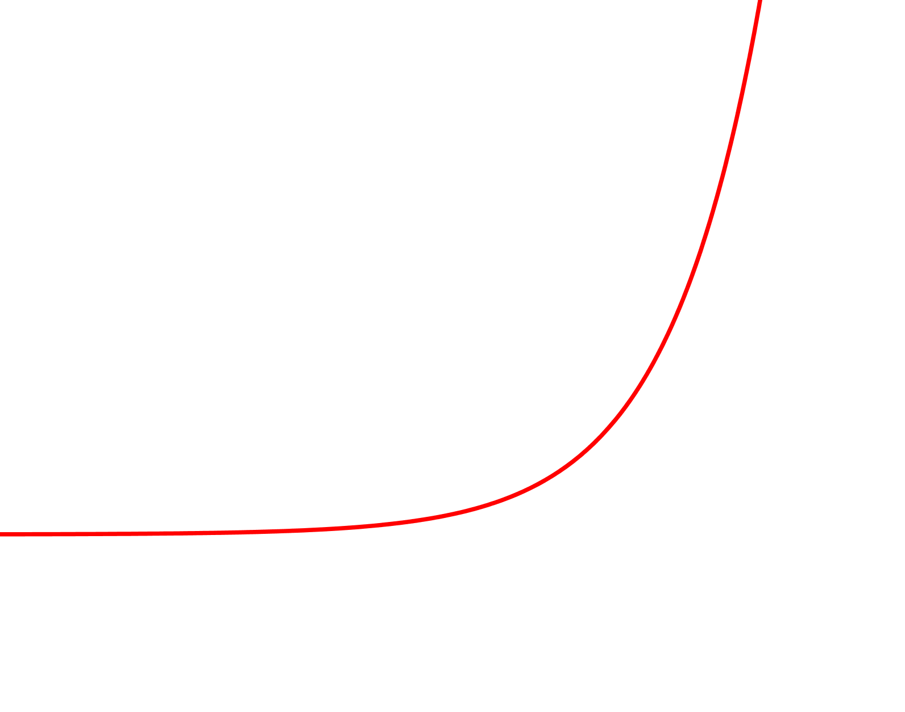
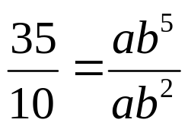
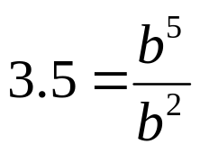

Example 3
Find an equation for the following exponential function?
y
(5, 35)
(2, 10)
o
x
Solution
Because function is exponential, y = ab^{x}. ---- (1)
Plugging point (5, 35) in (1): 35 = ab⁵ ---- (2)
Plugging point (2, 10) in (1): 10 = ab² ---- (3)
Dividing (2) by (3):
→
→

Slide 9

Therefore,
Then, b = 1.5182945 ----- (4)
Seven decimal places
Now, plug result (4) into equation (3)
10 = a (1.5182945)²
a = 10 / (1.5182945)² ≈ 4.3379842 ---- (5)
Seven decimal places
Because we found a = 4.3379842 and b = 1.5182945, we are ready to write the
exponential function rounded to six decimal places.
y = 4.337984 (1.518295)^{x}
Answer
Six decimal places
Let’s check the equation we found:
If x = 2 →
y = 4.337984 (1.518295)² ≈ 10.000006
Yes!!
If x = 5 →
y = 4.337984 (1.518295)⁵ ≈ 35.000057
Yes!!

Slide 10
Example 4
The initial value of a car was $45,000 in the year 2006 and
decreases exponentially. After 5 years, its value became 50% of its
initial value. Find a formula to represent its value V (in dollars)
in function of t, the number of years after year 2006.
Solution
Because depreciation is exponential, V(t) = ab^{t}. ---- (1)
According to the problem, initial value = 45000 and V(5) = 50% of 45000 = 22500.
Therefore, (0, 45000) and (5, 22500) are points from function V(t).
Plugging (5, 22500) in (1): 22500 = ab⁵ ---- (2)
Because V = 45000 occurs when t = 0, we can state that a = 45000.
Then, equation (2) becomes 22500 = 45000b⁵
→
b⁵ = 0.5
→
b = 0.5^(1/5)
Therefore, b ≈ 0.8705506.
After plugging a = 45000 and b = 0.870551 in (1)
→
V(t) = 45000 (0.870551) ^{t}
Answer

Slide 11
Example 5
In Example 4, we found that the car’s value depreciated according to
the function V(t) = 45000 (0.870551)^{t}.
By what percent did the car depreciate annually?
Solution
The function representing the car’s value is V(t) = 45000 (0.870551) ^{t}.
Then, the decay factor is 0.870551.
It means that the car’s value is multiplied by 0.870551 every time t increases
1 year.
Thus, every year, the car’s value has been decreasing 1 – 0.870551
or 0.129449 or 12.9449%.
Answer: The car’s value has been depreciating 12.9449% every year, since 2006.

Slide 12
Example 6
Find the points of intersection of y = 3 (1.025)^{t} and y = 5 + 0.08t.
Solution
To find the coordinates of the points of intersection, we write:
3 (1.025)^{t} = 5 + 0.08t
Because the variable t is an exponent in the left side of the equation 3 (1.025)^{t}
and t is a factor in a term from the right side 5 + 0.08t, this equation cannot be
solved algebraically.
But, it can be solved graphically.

Slide 13


By using a graphing calculator we can get the following graph. The two graphs
intersect at points A and B.
y
10
B
A
x
o
80
By using the procedure explained in Example 6 from class notes “Lesson 3.1”
we can find the following points of intersection.
A(– 52.155, 0.828) and B(41.188, 8.295)
Answer

